Slide 1


KDI：Construction of Floral Knowledge Graph with Data Integration
Reporter ：李辰宇

Slide 2

1 Contributors
ID | Name | Role
2023532027 | 李辰宇 | Knowledge Engineer
2023534036 | 李永桢 | Data Scientist
2023532106 | 张云霞 | Project Manager

Slide 3
2 Project description
When I moved to the new office and saw an empty desk, I wanted to buy a Flower. My requirements are:
My Position: “Office”
My Position Environment: “Sunny”
Floral Function: “air purification” “radiation protection” Floral Types: “ornamental qualities”

Slide 4
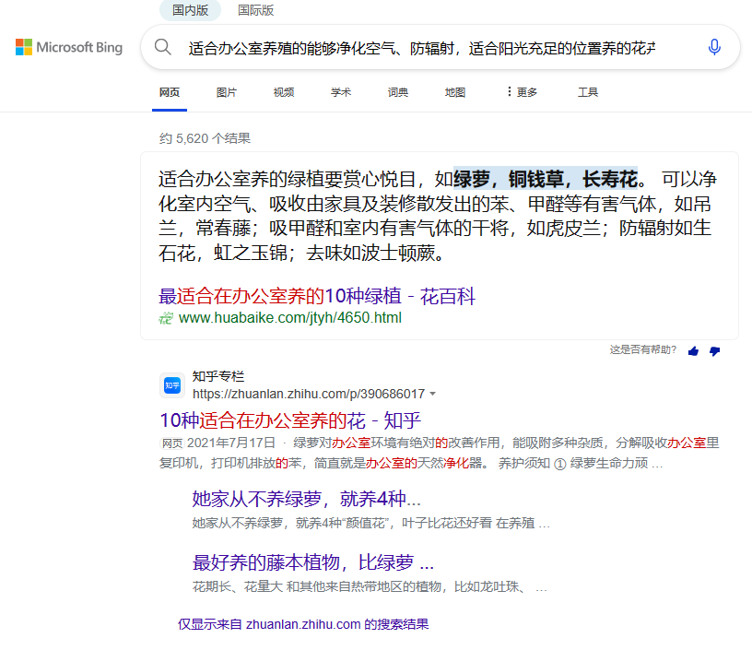
2 Project description

Slide 5
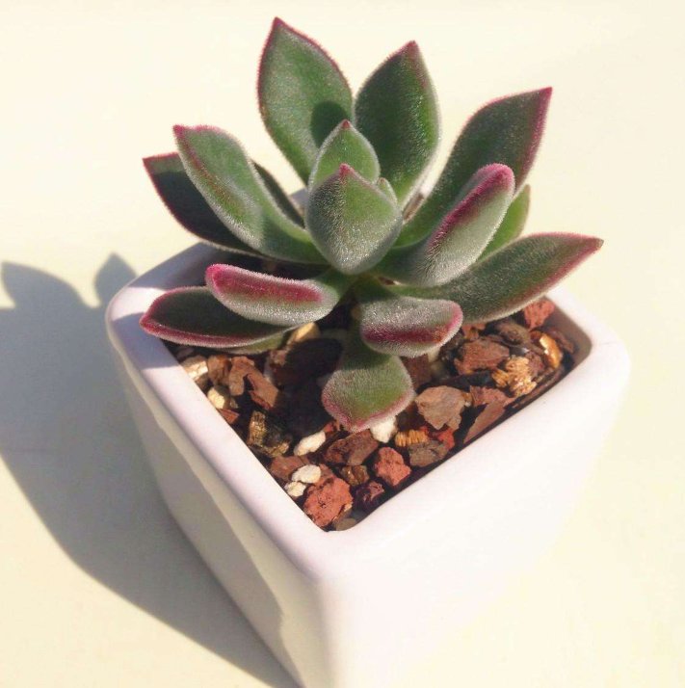
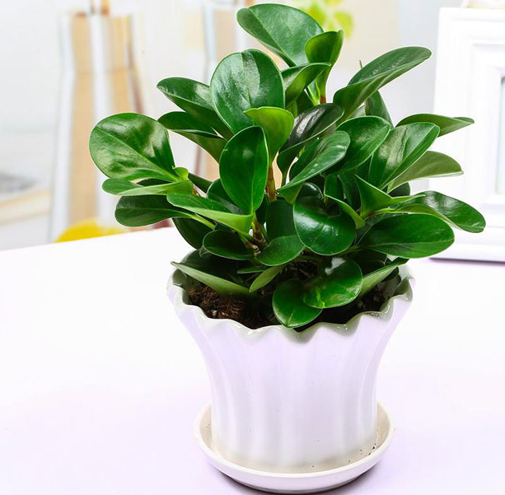

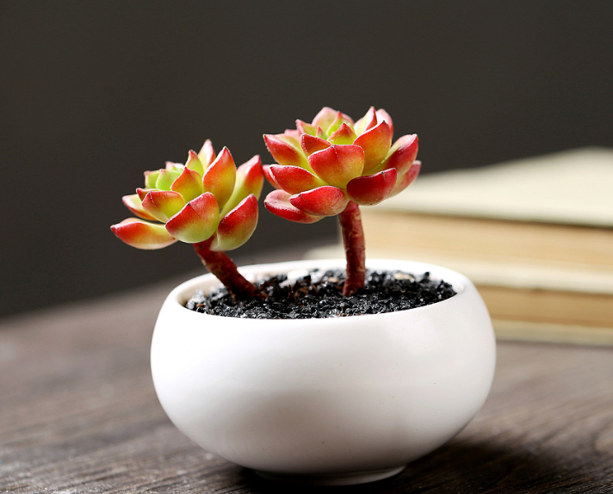
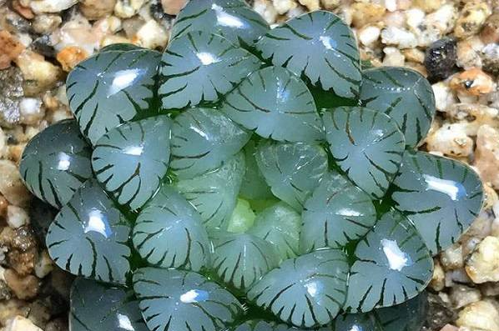
2 Project description
generated by ERNIE 4.0

Slide 6
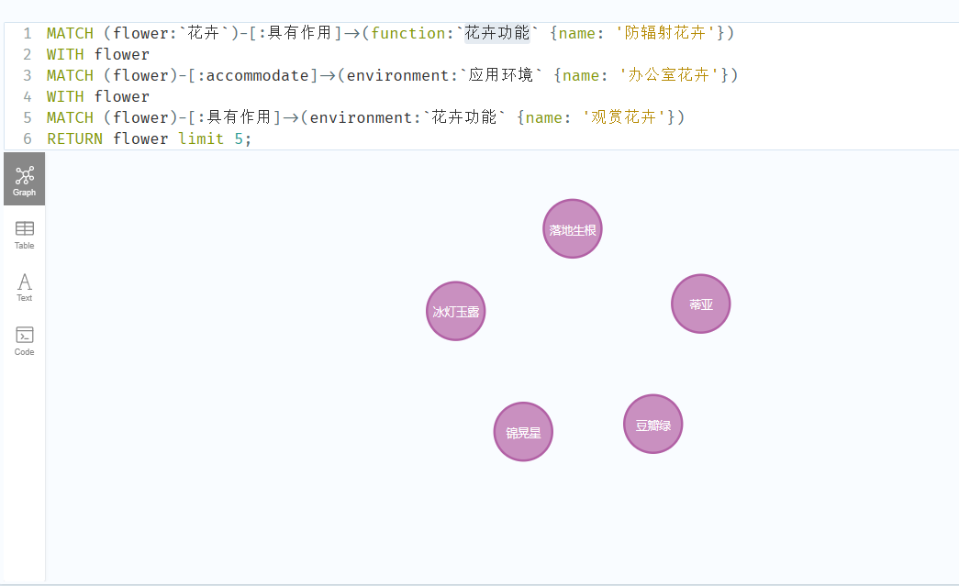
2 Project description

Slide 7
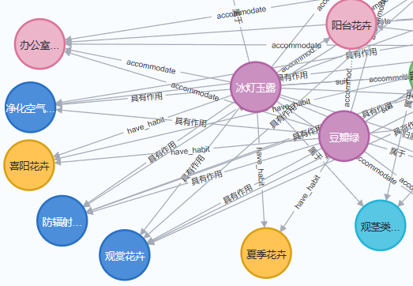
2 Project description

Slide 8
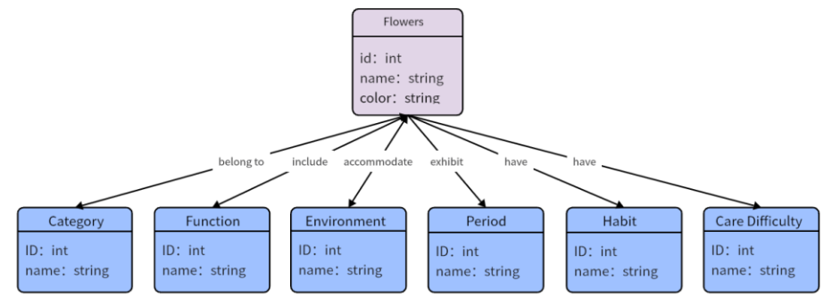
2 ER

Slide 9
3、Purpose
This person is looking for recommended flowers for his situation
Raw Competency Questions:
CQ1: What kind of flowers are suitable for a sunny new office?
CQ2: What should be noticed when cultivating flowers in a living room with insufficient sunlight?
Kernel Competency Questions: CQ1: Flower selection, Suitability, Sunny location, New office
CQ2: Flower selection, Notice, Living room, Insufficient sunlight

Slide 10
3、Purpose
This person is looking for recommended flowers for his situation
Analysed Competency Questions
CQ1
**common:** Flower, Environment
**core:** Suitability，Flower selection
**contextual:** Sunny location, New office
CQ2
**common:** Flower , Environment
**core:** notice, Flower selection
**contextual:** Living room, Insufficient sunlight

Slide 11
3、Purpose
This person is looking for recommended flowers for his situation
Classified Competency Questions
CQ1 Common OBJECT：Flower, Environment
Core FUNCTION: Suitability ACTION: Flower selection
Contextual FUNCTION: Sunny location, New office
CQ2 Common OBJECT：Flower, Environment
Core FUNCTION: Notice ACTION: Flower selection
Contextual FUNCTION: Living room, Insufficient sunlight

Slide 12
3、Purpose
This person is looking for recommended flowers for his situation
Attributed Competency Questions
CQ1
For(Flowers): id, name, color
For( Environment): id, string
CQ2
For(Flowers): id, name, color
For( Environment): id, string

Slide 13
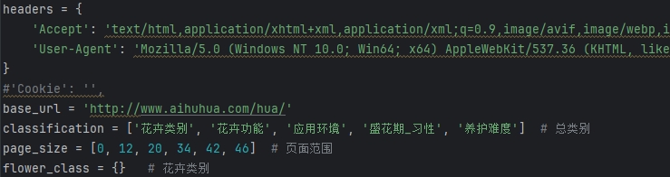
4、Crawl data

Slide 14
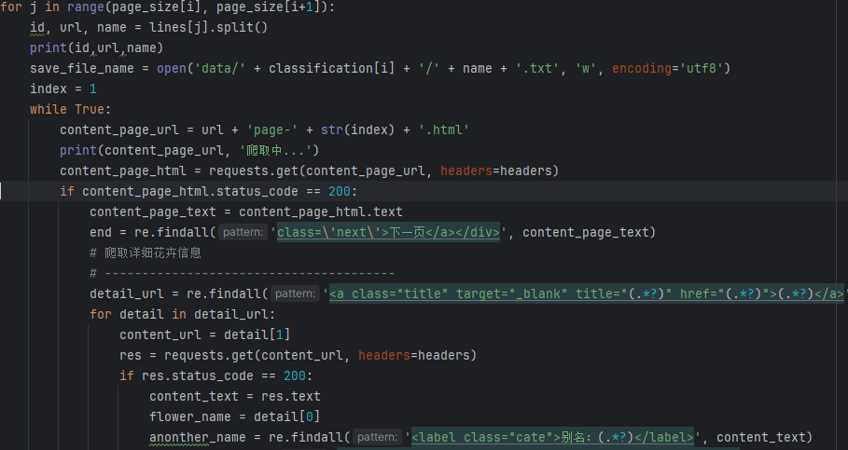
4、Crawl data

Slide 15
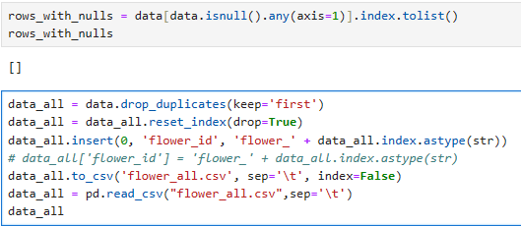
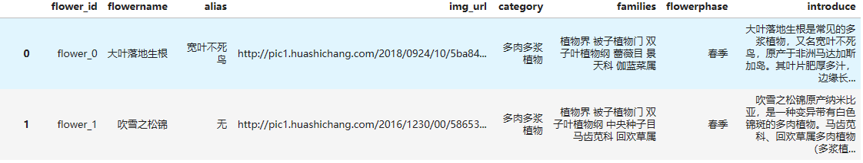
5、Data alignment

Slide 16
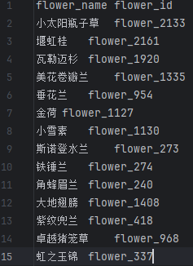
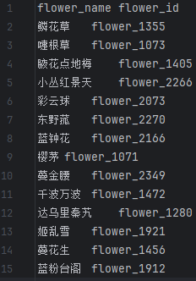
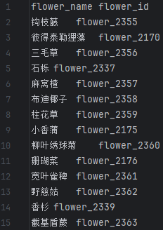
5、Data alignment
Professionally maintained flowers
Easy maintenance flowers
Sun-loving flower

Slide 17
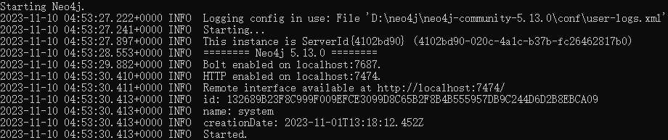
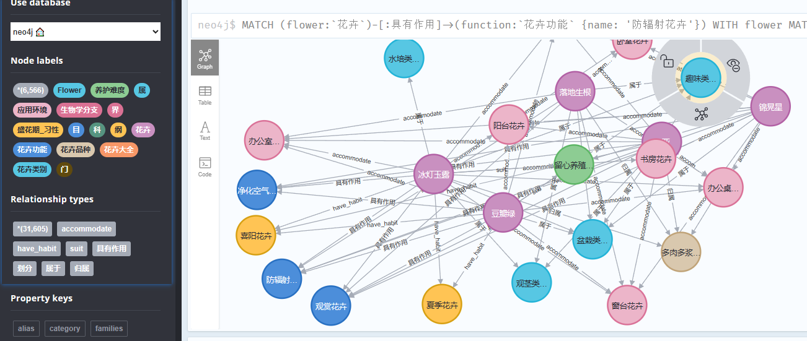
5、Constructing KG

Slide 18
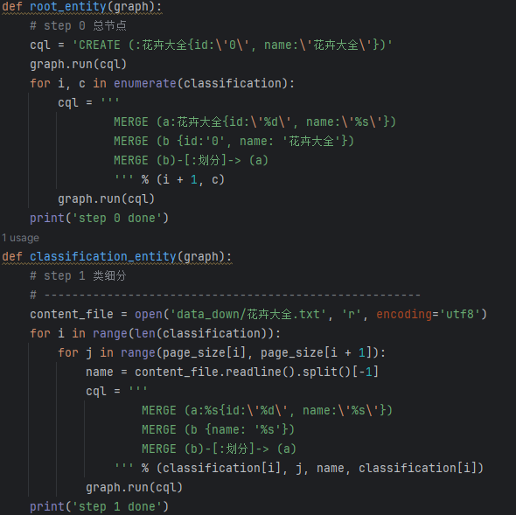
5、 Constructing KG

Slide 19
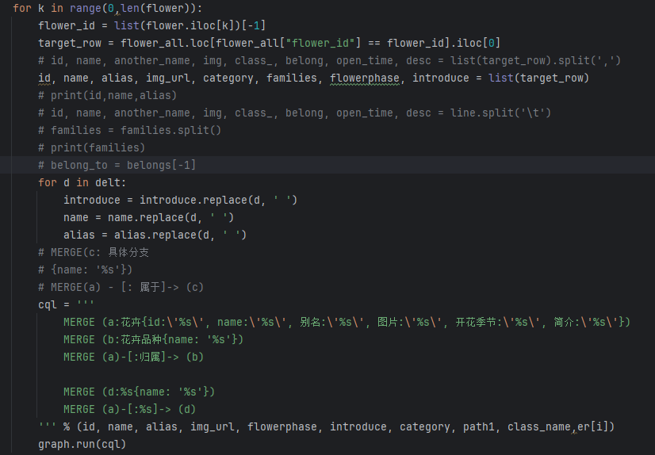
5、 Constructing KG

Slide 20
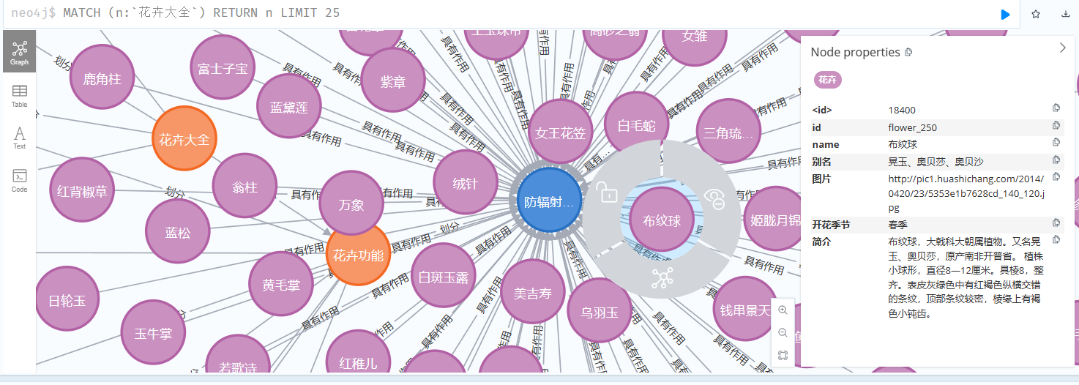
5、实验分析

Slide 21
Thanks！

